Slide 1
Characterizing Brain Networks Across Scanners with Topological Data Analysis (TDA)
Ahmedur Rahman Shovon
PhD (CS) Student
UIC

Slide 2
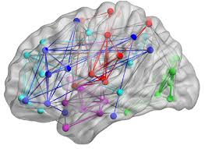
What is a brain network?
Notes:
A brain network is a system of interconnected brain regions that communicate with each other to perform various cognitive, sensory, or motor functions.

Slide 3
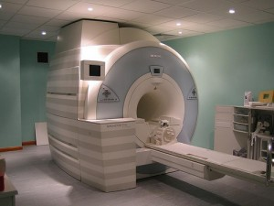
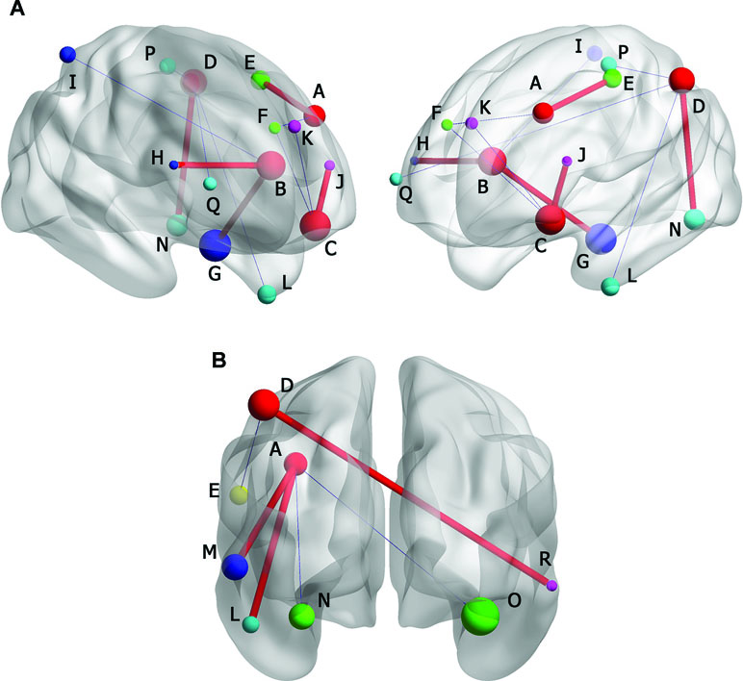
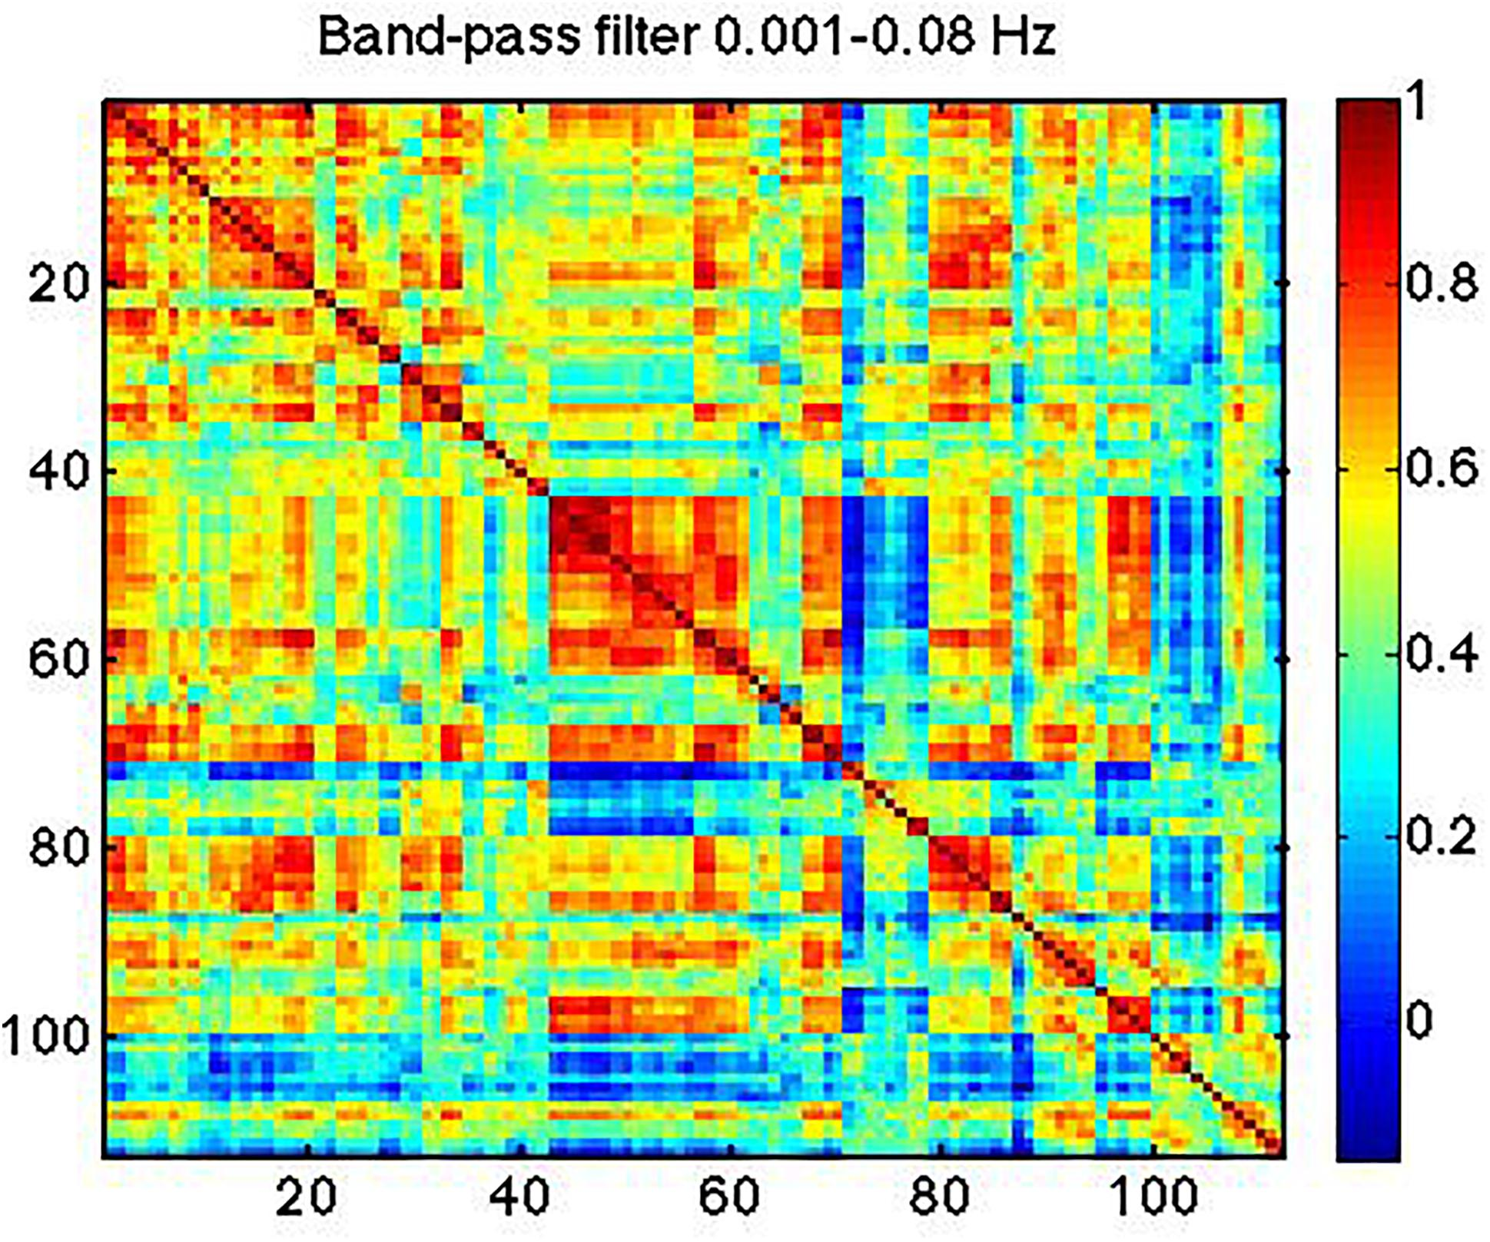
How to construct brain network?
Notes:
MRI scanner captures brain activity. resting-state functional magnetic resonance imaging (fMRI)
Fmri images show the connection strength between various regions, representing how these areas communicate with each other.
In FCN the colors indicate the strength of connections between different brain regions

Slide 4
How to construct brain network?
Notes:
a brain network refers to a set of interconnected regions in the brain that work together to perform specific functions.
MRI scanner captures brain activity. Fmri images show the connection strength between various regions, representing how these areas communicate with each other.
In FCN the colors indicate the strength of connections between different brain regions

Slide 5
How to construct brain network?
Notes:
a brain network refers to a set of interconnected regions in the brain that work together to perform specific functions.
MRI scanner captures brain activity
different parts of the brain are connected to each other, the signal in one part triggers something in other parts which is the edge of the FCN
and this FCN are important biomarkers for catching a lot of diseases
how the connectivity of the brain is depends on a lot of conditions (diseases)

Slide 6

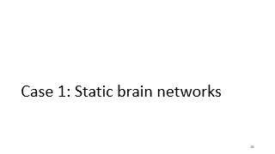
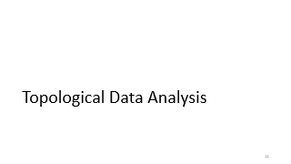
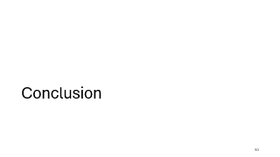

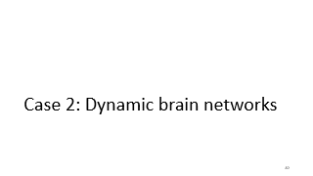
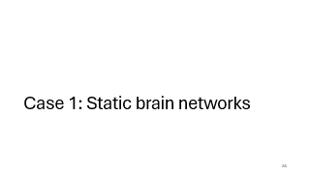
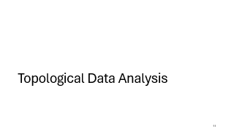
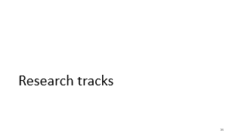


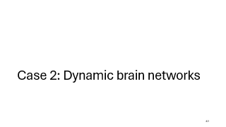
Roadmap

Slide 7
Background

Slide 8
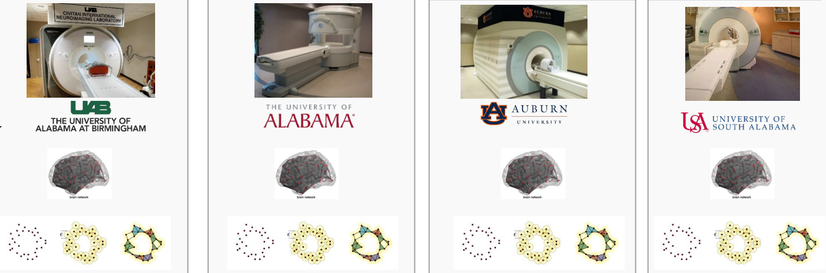
Multi-site rs-fMRI studies allow gathering
larger sample sizes
B. B. Biswal, M. Mennes, X.-N. Zuo, S. Gohel, C. Kelly, S. M. Smith, C. F. Beckmann, J. S. Adelstein, R. L. Buckner, S. Colcombe et al., “Toward discovery science of human brain function,” Proceedings of the national academy of sciences, vol. 107, no. 10, pp. 4734–4739, 2010.

Slide 9
But different scanners and sampling periods
negates the advantages of larger sample sizes
C. Dansereau, Y. Benhajali, C. Risterucci, E. M. Pich, P. Orban, D. Arnold, and P. Bellec, “Statistical power and prediction accuracy in multisite resting-state fmri connectivity,” Neuroimage, vol. 149, pp. 220–232, 2017.

Slide 10
Convert fMRI image to FCN
Apply Topological Data Analysis on FCN

Slide 11
Topological Data Analysis

Slide 12
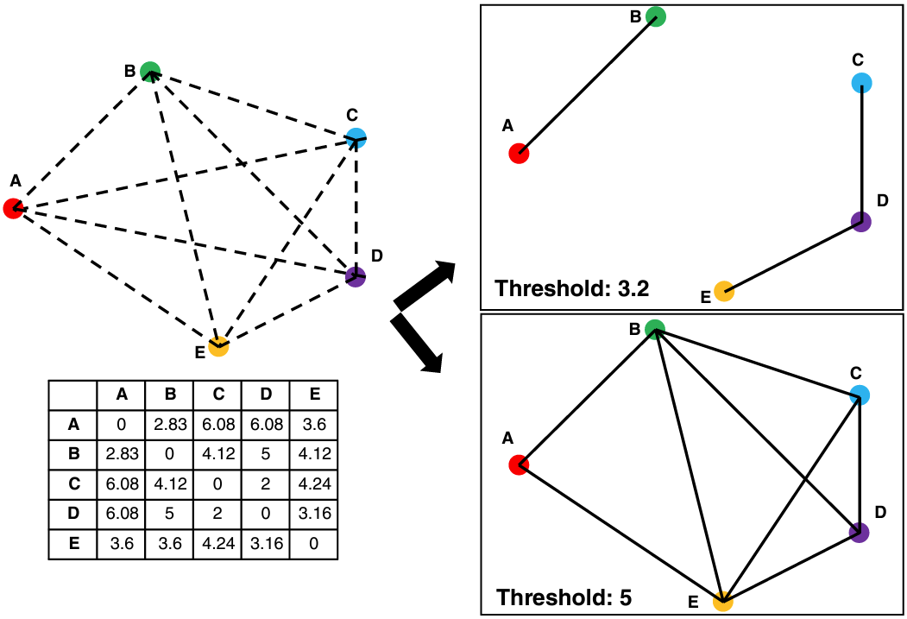
Graph Analytics

Slide 13
Graph Analytics

Slide 14
Graph Analytics

Slide 15
Graph Analytics
Two thresholds yield graphs of completely different topologies!

Slide 16
Topological Data Analysis (TDA)
No need to pick a specific threshold, TDA sweeps the entire threshold space
Main tool: persistent homology, adapts homology to point cloud
Analyzes complex systems: social networks, brain connectivity, internet
Extracts topological features and visualizes in lower-dimensional space
M. Rubinov and O. Sporns, “Complex network measures of brain connectivity: uses and interpretations,” Neuroimage, vol. 52, no. 3, pp. 1059–1069, 2010.
Aktas, M.E., Akbas, E. & Fatmaoui, A.E. Persistence homology of networks: methods and applications. Appl Netw Sci 4, 61 (2019). https://doi.org/10.1007/s41109-019-0179-3

Slide 17
Persistent Homology (PH)
Uses simplicial complexes to analyze network connections
Detects topological features across thresholds
0-simplex (connected component)
1-simplex (tunnel)
2-simplex (void)
M. Rubinov and O. Sporns, “Complex network measures of brain connectivity: uses and interpretations,” Neuroimage, vol. 52, no. 3, pp. 1059–1069, 2010.
Aktas, M.E., Akbas, E. & Fatmaoui, A.E. Persistence homology of networks: methods and applications. Appl Netw Sci 4, 61 (2019). https://doi.org/10.1007/s41109-019-0179-3

Slide 18
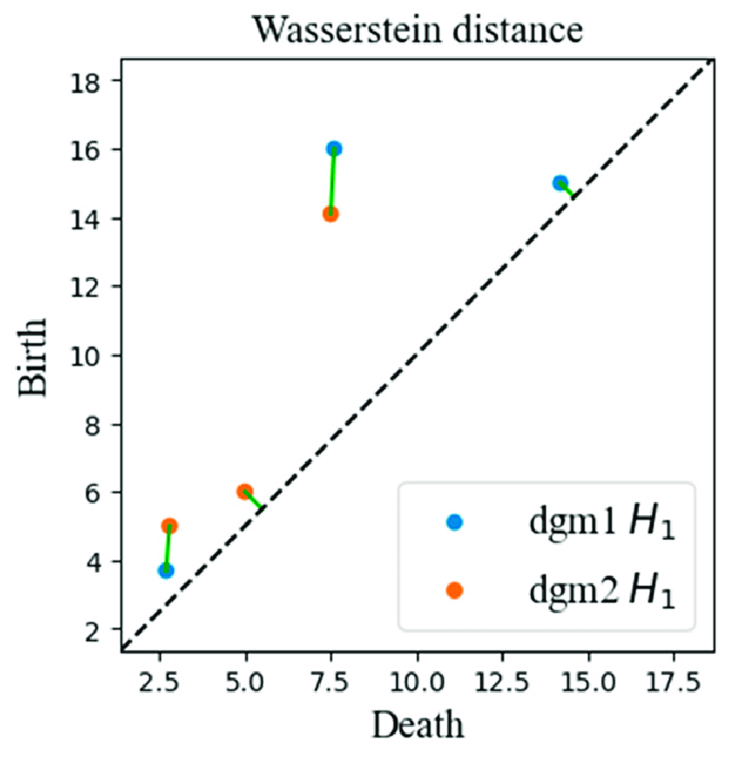
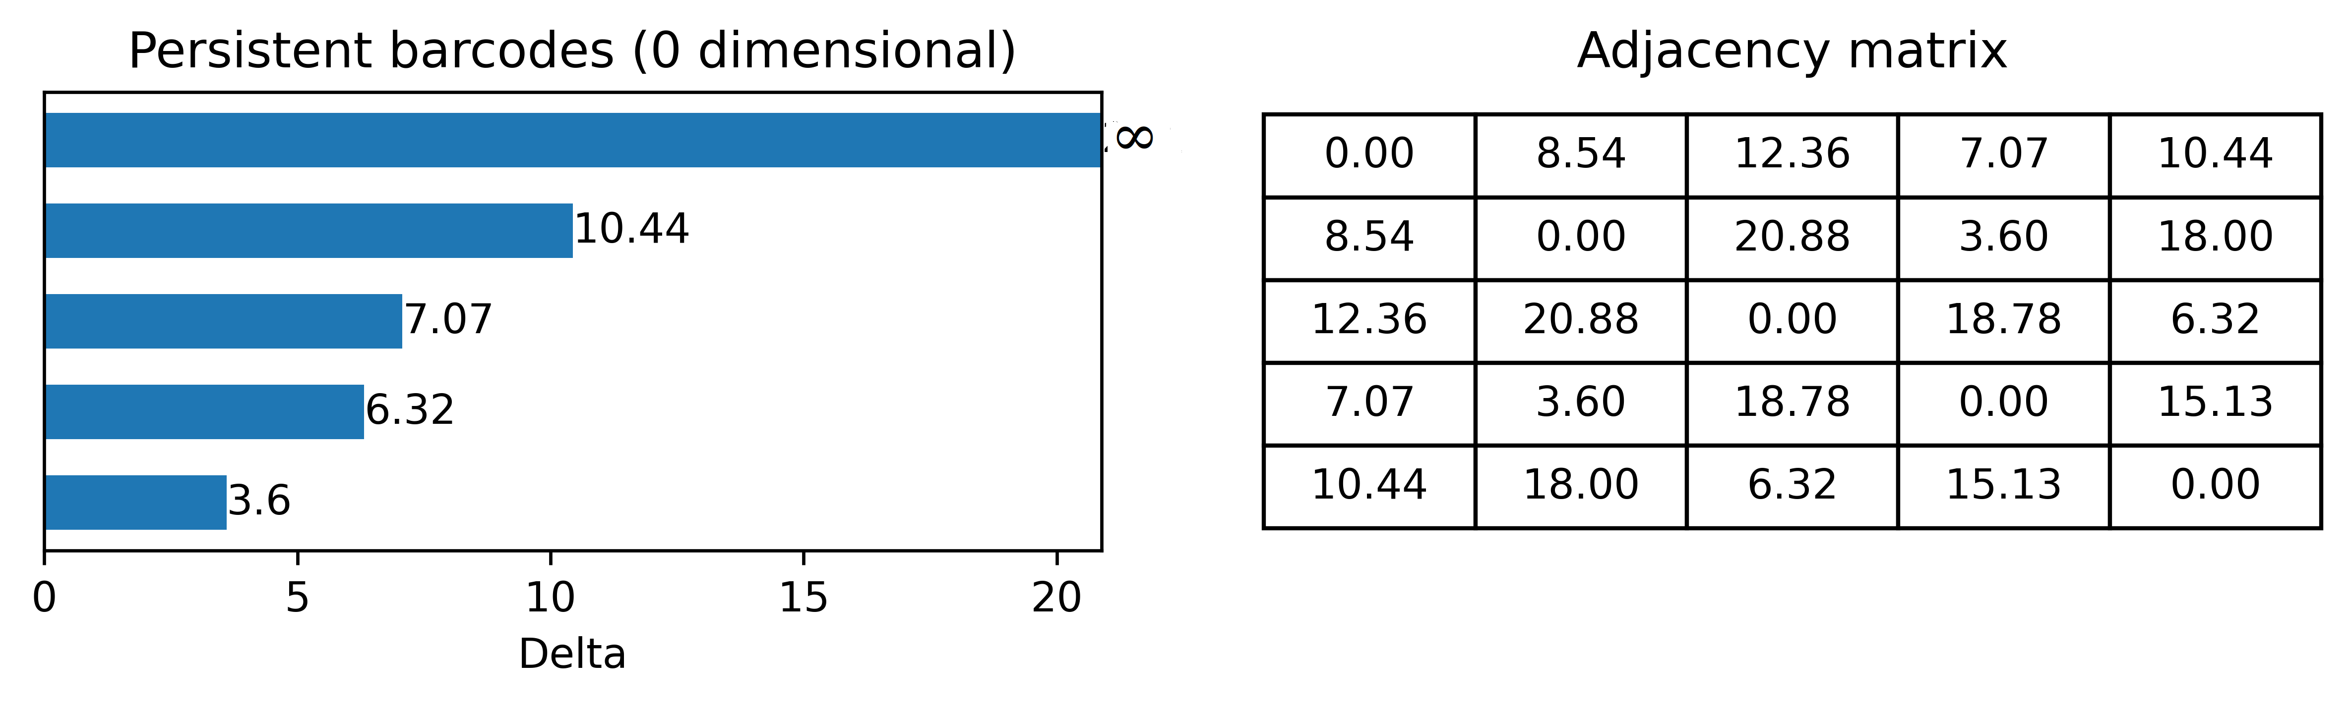
Barcodes and Persistent Diagram
PH Tracks birth and death of features in the graph
Barcodes: each bar shows when each features born and die
Persistent diagram: shows persistent barcodes in 2D
Aktas, M.E., Akbas, E. & Fatmaoui, A.E. Persistence homology of networks: methods and applications. Appl Netw Sci 4, 61 (2019). https://doi.org/10.1007/s41109-019-0179-3

Slide 19
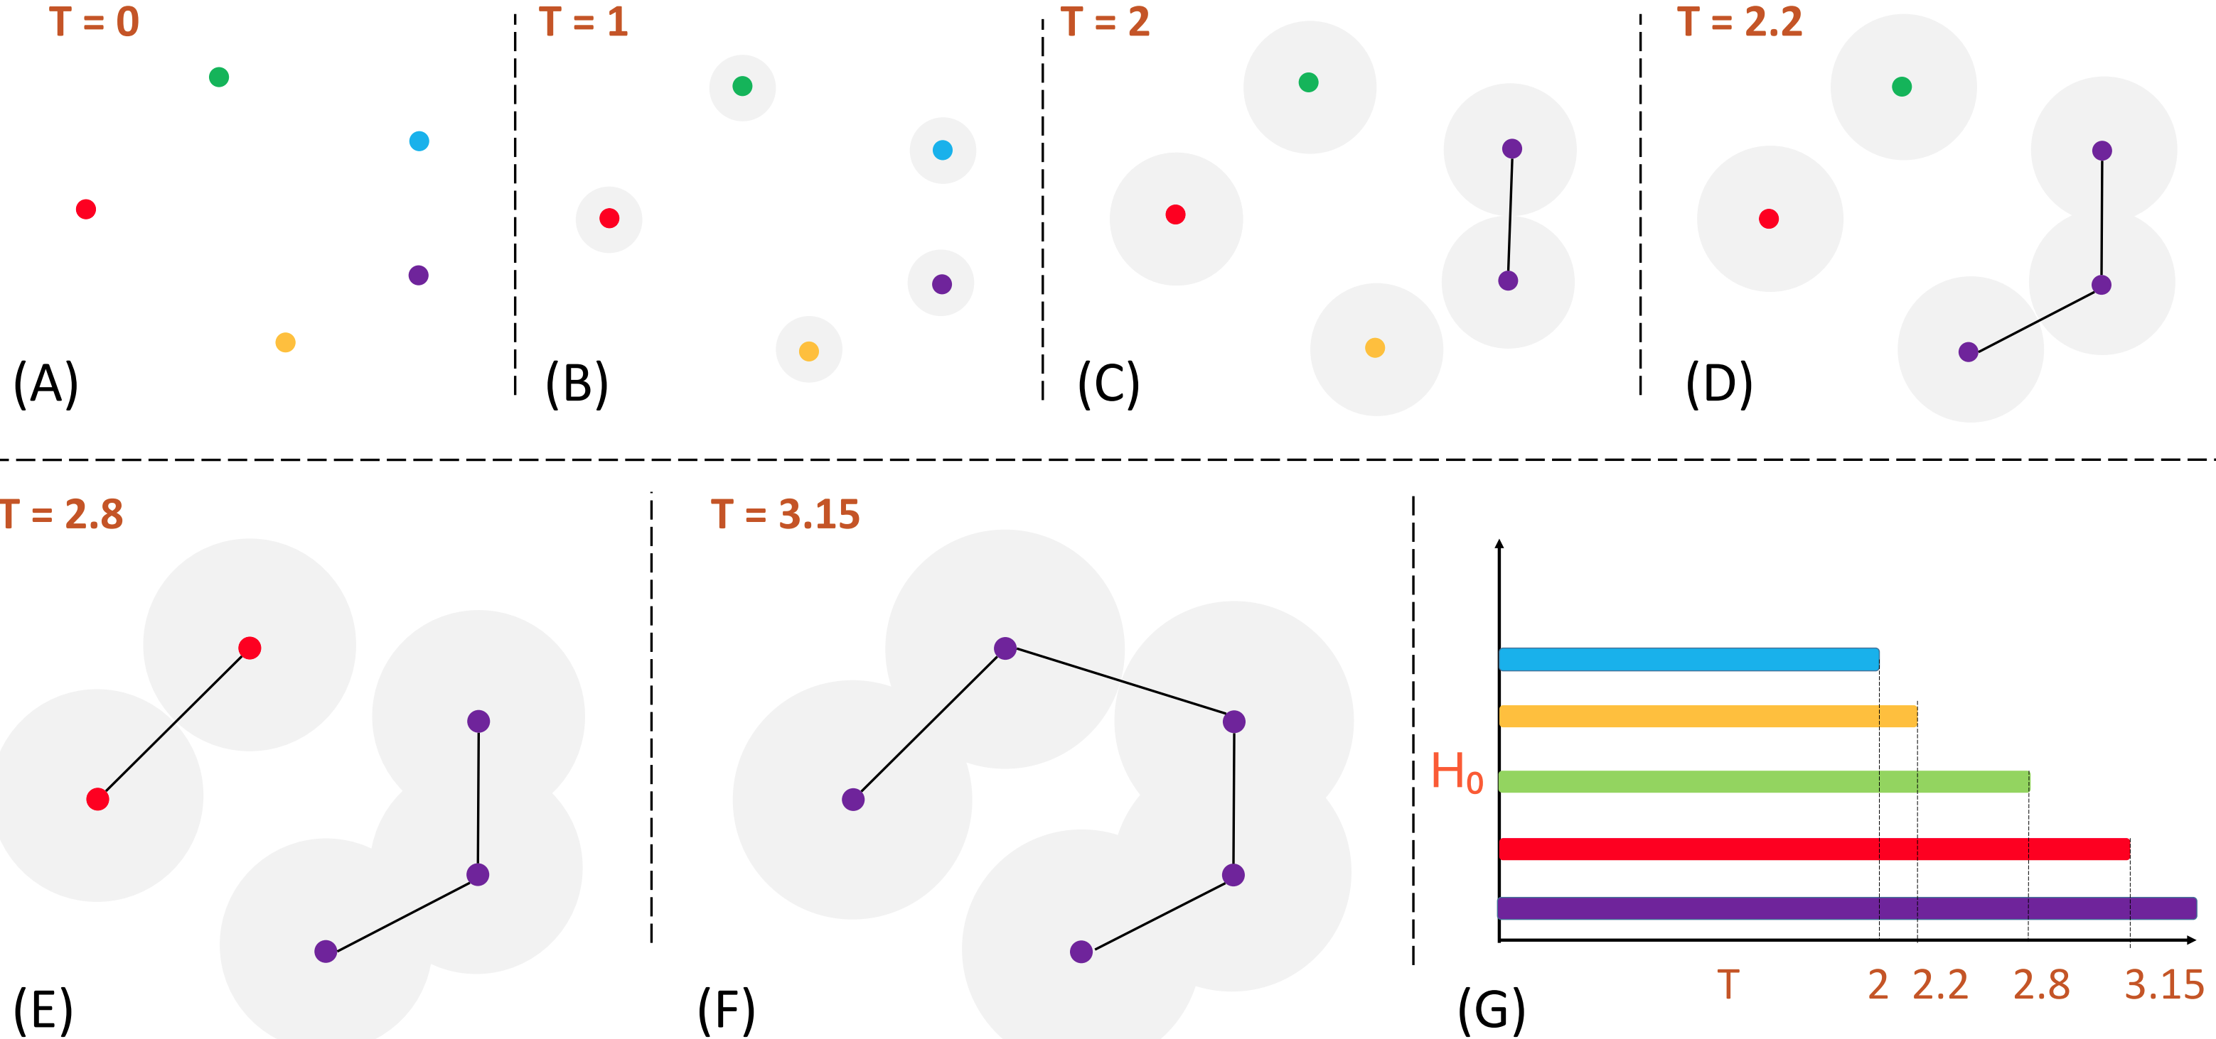
Computing Persistent Homology (Point Cloud)

Slide 20
Computing Persistent Homology (Point Cloud)

Slide 21
Computing Persistent Homology (Point Cloud)

Slide 22
Computing Persistent Homology (Point Cloud)

Slide 23
Computing Persistent Homology (Point Cloud)

Slide 24
Computing Persistent Homology (Point Cloud)

Slide 25
Wasserstein distance (WD)
Measures distance between two probability distributions
Minimum amount of work required to transform u into v, work = distribution weight x distance
Minimum value achieved by a perfect matching between the features of two Persistent Diagrams
S. Vallender, “Calculation of the wasserstein distance between probability distributions on the line,” Theory of Probability & Its Applications, vol. 18, no. 4, pp. 784–786, 1974.
H. Edelsbrunner, “Persistent homology: theory and practice,” 2013.
Qingzhang, Shi. (2021). Time Series Clustering with Topological and Geometric Mixed Distance. Mathematics. 9. 10.3390/math9091046.

Slide 26
Research tracks

Slide 27
PH for High-Dimensional Data Analysis
Verify
PH of rs-fMRI can compactly represent topological features of FCNs
Demonstrate
FCN networks are statistically similar despite variations in TRs
Remove
Non-neural variability in multi-site case-control studies for static and dynamic brain networks
Ashley Suh, Mustafa Hajij, Bei Wang, Carlos Scheidegger, and Paul Rosen. Persistent homologyguided force-directed graph layouts. IEEE Transactions on Visualization and Computer Graphics,26(1):697–707, January 2020
Tananun Songdechakraiwut, Li Shen, and Moo Chung. Topological learning and its application tomultimodal brain network integration. In Medical Image Computing and Computer Assisted Intervention–MICCAI 2021: 24th International Conference, Strasbourg, France, September 27–October 1, 2021,Proceedings, Part II 24, pages 166–176. Springer, 2021.

Slide 28
Case 1: Static brain networks

Slide 29
Experimental data
rs-fMRI data from NKI-RS public database
3 temporal sampling rates 645ms, 1400ms, 2500ms
Total 316 subjects
Mean time series from 113 brain regions
One weighted network per fMRI scan
K. B. Nooner, S. Colcombe, R. Tobe, M. Mennes, M. Benedict, A. Moreno, L. Panek, S. Brown, S. Zavitz, Q. Li et al., “The nki-rockland sample: a model for accelerating the pace of discovery science in psychiatry,” Frontiers in neuroscience, vol. 6, p. 152, 2012.

Slide 30
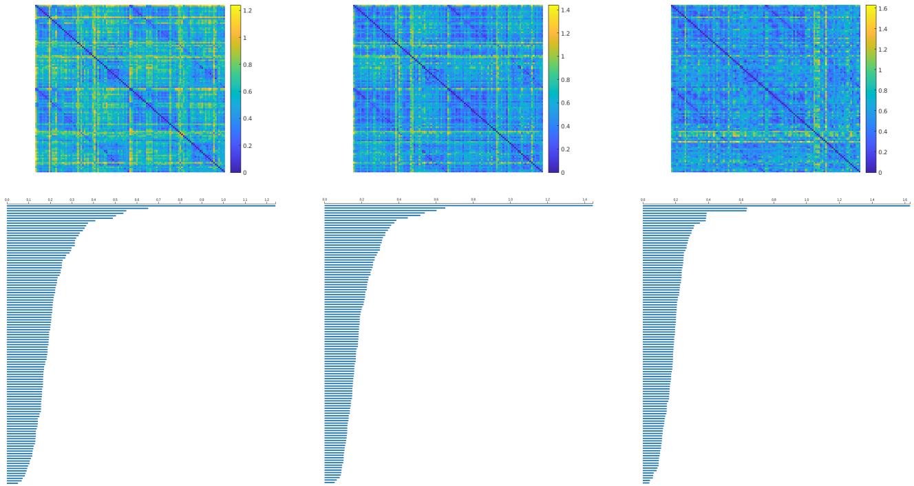
Apply PH to FCN
Apply PH on the metric space to extract topological features
Compute 0-dimensional barcodes for all FCNs (3 x 316)
FCN (top-row) and extracted topological feature (bottom-row) for subject 31 for 645ms (left), 1400ms (center), and 2500ms (right)
The GUDHI Project, GUDHI User and Reference Manual. GUDHI Editorial Board, 2015. [Online]. Available: http://gudhi.gforge.inria.fr/doc/latest/
M. Kerber, D. Morozov, and A. Nigmetov, “Geometry helps to compare persistence diagrams,” Journal of Experimental Algorithmics (JEA), vol. 22, pp. 1–20, 2017.

Slide 31
Statistical analysis on PDs
Convert barcodes to persistent diagram (PD)
Quantify the difference between two PDs using Wasserstein distance
Statistical analysis:
Across cohort study
Within cohort study

Slide 32
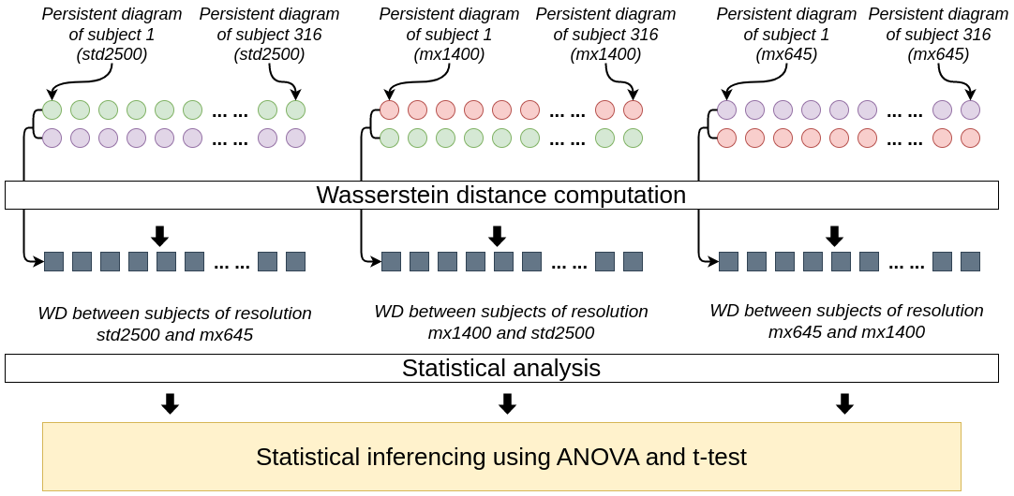
Across Cohort Study
Perform comparison of PDs across cohorts using Wasserstein distance
Pipeline to compare WD across cohorts
R. T. Shinohara, J. Oh, G. Nair, P. A. Calabresi, C. Davatzikos, J. Doshi, R. G.Henry, G. Kim, K. A. Linn, N. Papinutto et al., “Volumetric analysis from a harmonized multisite brain mri study of a single subject with multiple sclerosis,” American Journal of Neuroradiology, vol. 38, no. 8, pp. 1501–1509, 2017.

Slide 33
Across Cohort Study
Perform comparison of PDs across cohorts using Wasserstein distance
Form 3 distributions each with 316 datapoints
Pipeline to compare WD across cohorts
R. T. Shinohara, J. Oh, G. Nair, P. A. Calabresi, C. Davatzikos, J. Doshi, R. G.Henry, G. Kim, K. A. Linn, N. Papinutto et al., “Volumetric analysis from a harmonized multisite brain mri study of a single subject with multiple sclerosis,” American Journal of Neuroradiology, vol. 38, no. 8, pp. 1501–1509, 2017.

Slide 34
Across Cohort Study
Perform comparison of PDs across cohorts using Wasserstein distance
Form 3 distributions each with 316 datapoints
High p-value (>0.05) will indicate the null hypothesis is true
R. T. Shinohara, J. Oh, G. Nair, P. A. Calabresi, C. Davatzikos, J. Doshi, R. G.Henry, G. Kim, K. A. Linn, N. Papinutto et al., “Volumetric analysis from a harmonized multisite brain mri study of a single subject with multiple sclerosis,” American Journal of Neuroradiology, vol. 38, no. 8, pp. 1501–1509, 2017.

Slide 35
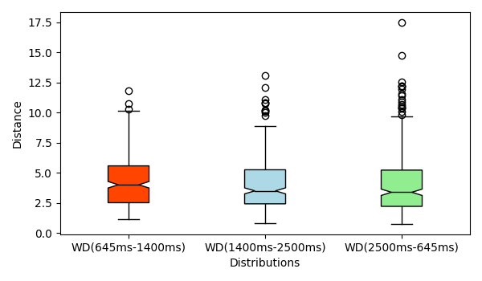
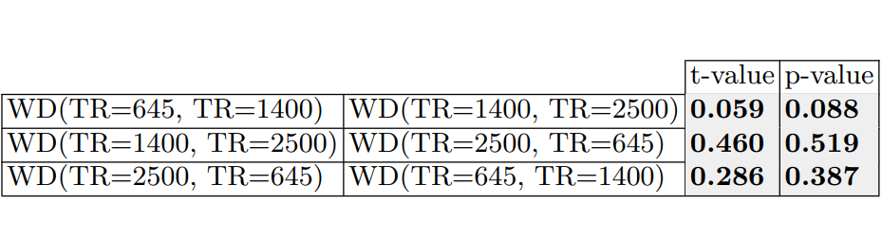
Across Cohort Study Results
Boxplots are aligned indicating similarity of the three distributions
ANOVA test yields p-value of 0.29
T-values and p-values >0.05
Boxplot and t-test results for across study, significance level of α = 0.05

Slide 36
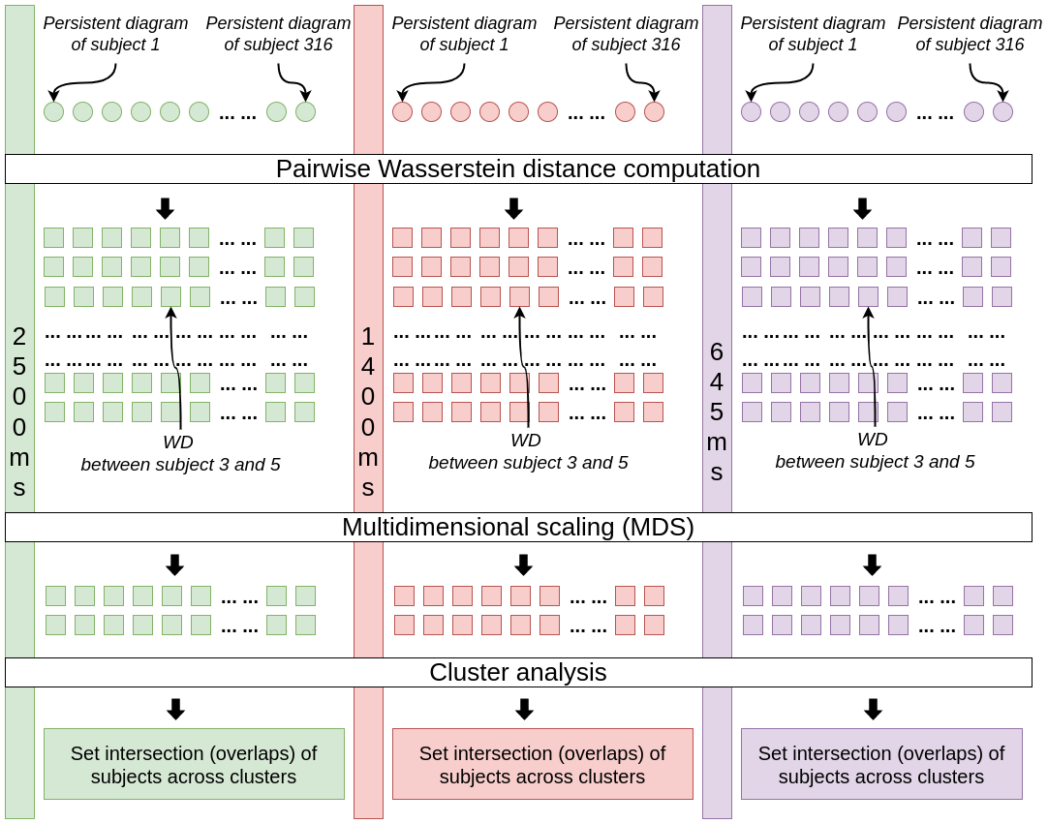
Within Cohort Study
Perform comparison of pairwise WD between PDs of subjects within each cohort
Generate 3 adjancency matrix of size 316 x 316
Pipeline to compare WD within a given cohort
Chung, M. K., Huang, S. G., Carroll, I. C., Calhoun, V. D., & Goldsmith, H. H. (2022). Dynamic Topological Data Analysis for Brain Networks via Wasserstein Graph Clustering. arXiv preprint arXiv:2201.00087.

Slide 37
Within Cohort Study
Perform comparison of pairwise WD between PDs of subjects within each cohort
Generate 3 adjancency matrix of size 316 x 316
Apply MDS to reduce matrix size 316 x 2
Apply K-Means clustering
Pipeline to compare WD within a given cohort
Chung, M. K., Huang, S. G., Carroll, I. C., Calhoun, V. D., & Goldsmith, H. H. (2022). Dynamic Topological Data Analysis for Brain Networks via Wasserstein Graph Clustering. arXiv preprint arXiv:2201.00087.

Slide 38
Within Cohort Study
Perform comparison of pairwise WD between PDs of subjects within each cohort
Generate 3 adjancency matrix of size 316 x 316
Apply MDS to reduce matrix size 316 x 2
Apply K-Means clustering
Computes set interaction of the subjects across clusters
Pipeline to compare WD within a given cohort
Chung, M. K., Huang, S. G., Carroll, I. C., Calhoun, V. D., & Goldsmith, H. H. (2022). Dynamic Topological Data Analysis for Brain Networks via Wasserstein Graph Clustering. arXiv preprint arXiv:2201.00087.

Slide 39
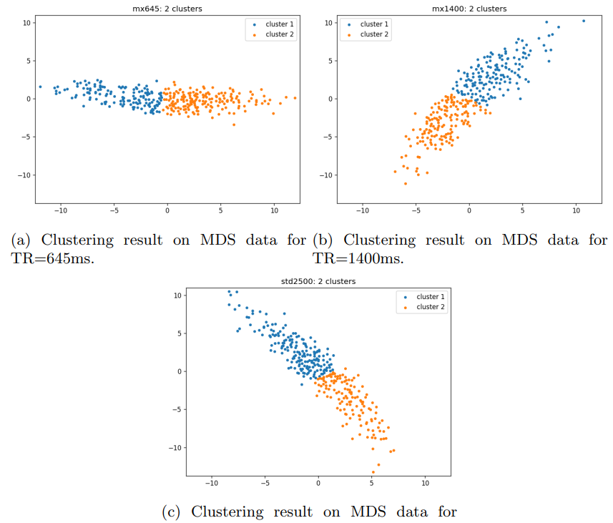
Within Cohort Study Results
198 out of 316 subjects reside in same cluster group in all 3 TRs
251 out of 316 subjects reside in same pairwise cluster intersection

Slide 40
Case 2: Dynamic brain networks

Slide 41
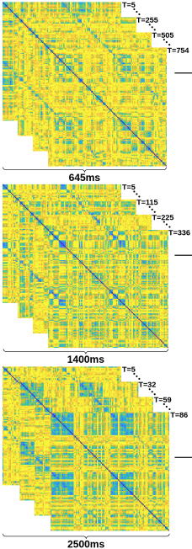
Dynamic brain networks
Examines temporal changes in brain activity from fMRI scans
High dimensionality makes data analysis challenging
Helps understand dynamic brain processes and evolving interactions

Slide 42
Experimental data
The temporal rs-fMRI data were acquired from 316 subjects using 3 temporal sampling rates with different timesteps:
645ms: 754 timesteps
1400ms: 336 timesteps
2500ms: 86 timesteps
Total adjacency matrices: 371,616 (316 × 86) + (316 × 336) + (316 × 754) with a dimension of 113 × 113

Slide 43
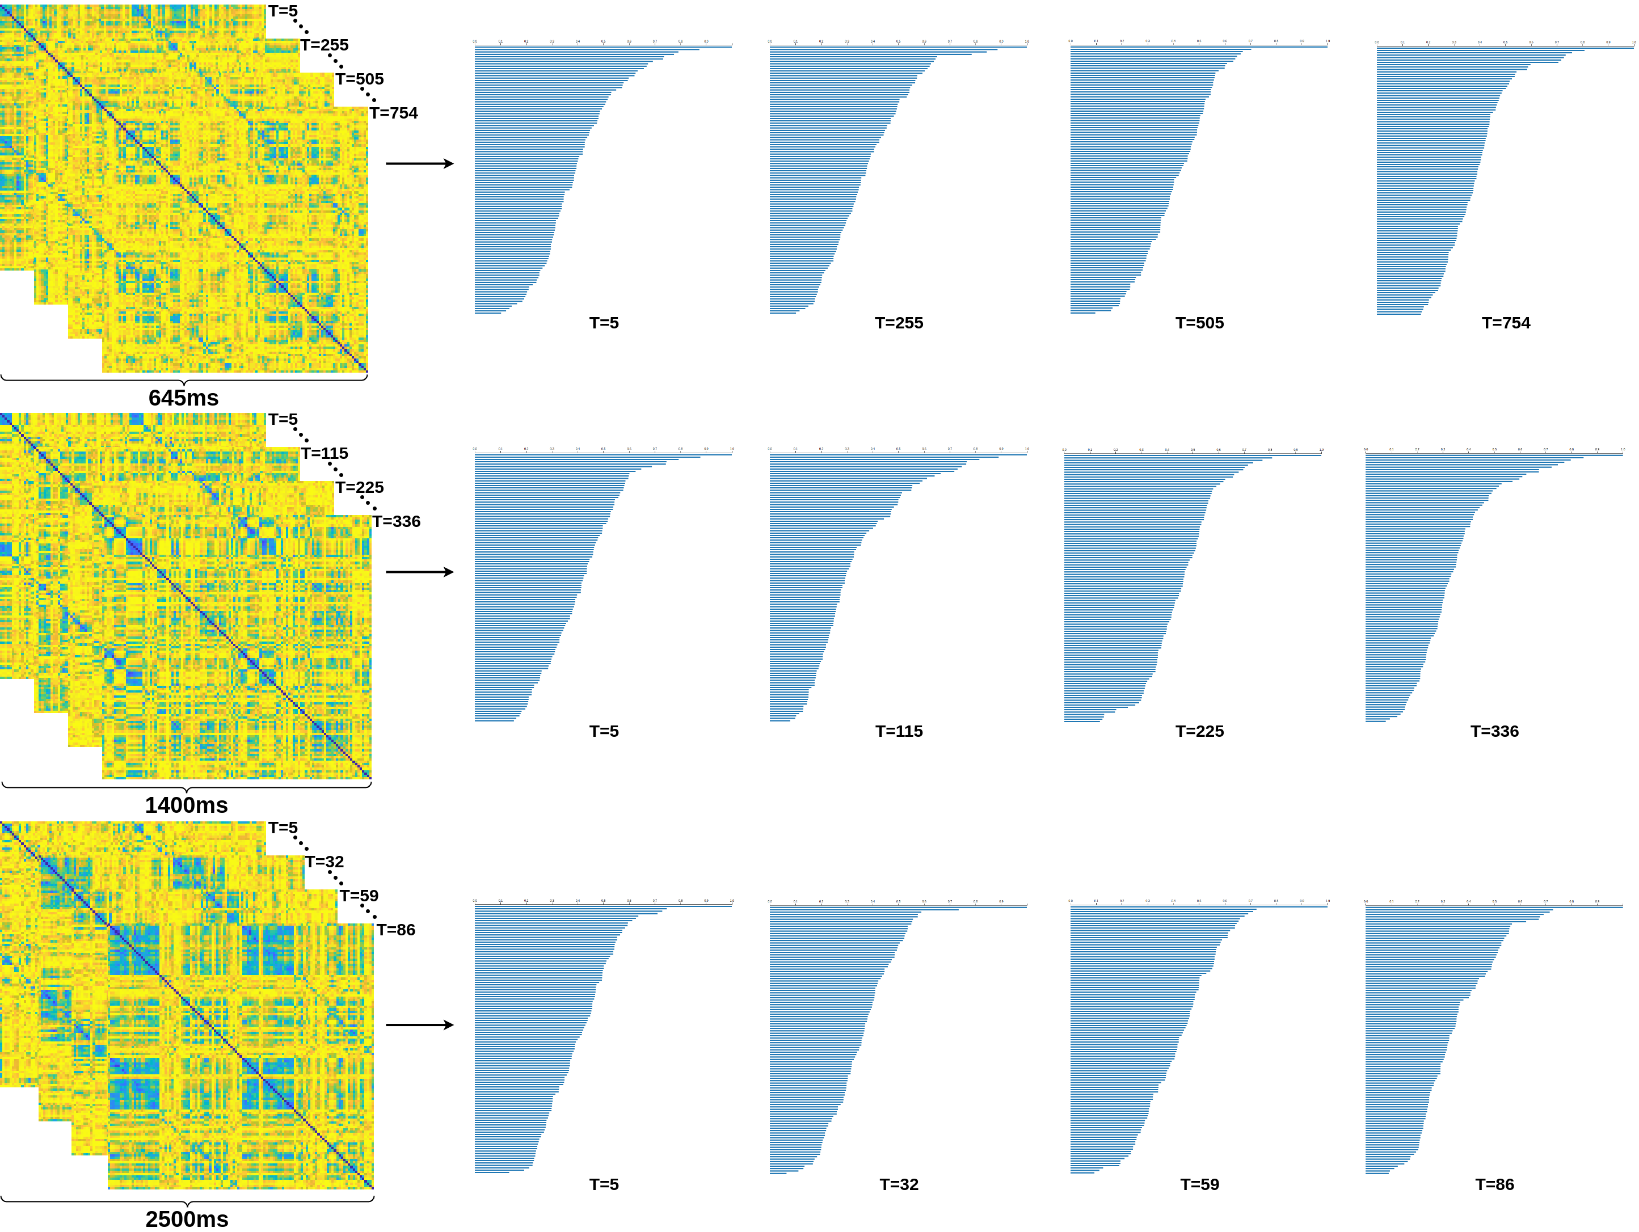
Apply PH to FCN
The FCN and extracted topological feature as 0-dimensional barcodes for subject 32 at different time points for temporal sampling periods 645ms (top), 1400ms (center), and 2500ms (bottom)

Slide 44
Topology assisted clustering
Discrete brain states Brain alternates between limited distinct states
High dimensional data 754, 336, 86 timesteps
Hypothesis Number of clusters should remain constant across different sampling rates

Slide 45
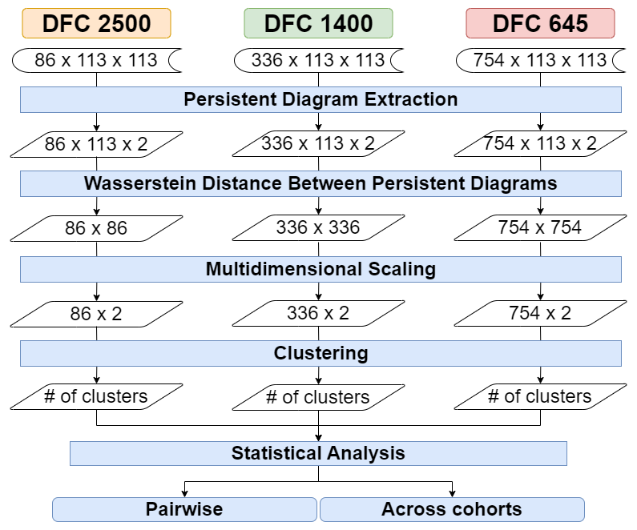
TDA based Pipeline
Topological data analysis pipeline for evaluating the robustness of persistent homology on different sampling periods of temporal rs-fMRI data extracted at 3 sampling periods 2500ms (left), 1400ms (center) and 645ms (right)

Slide 46
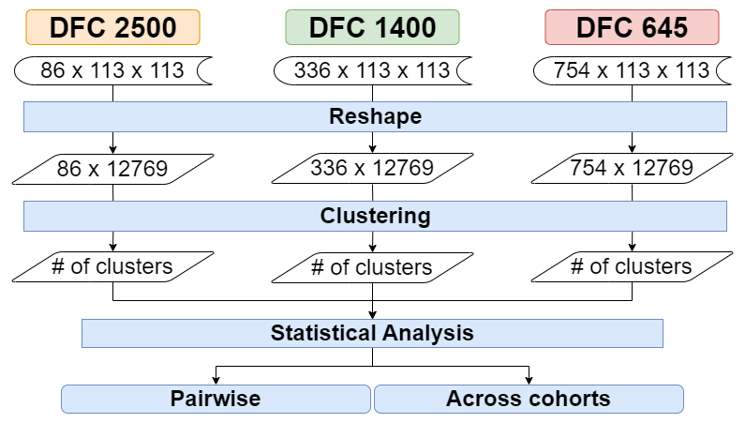
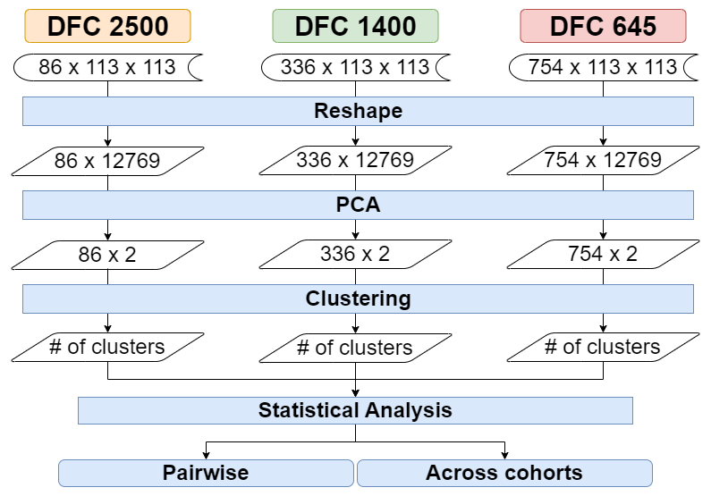
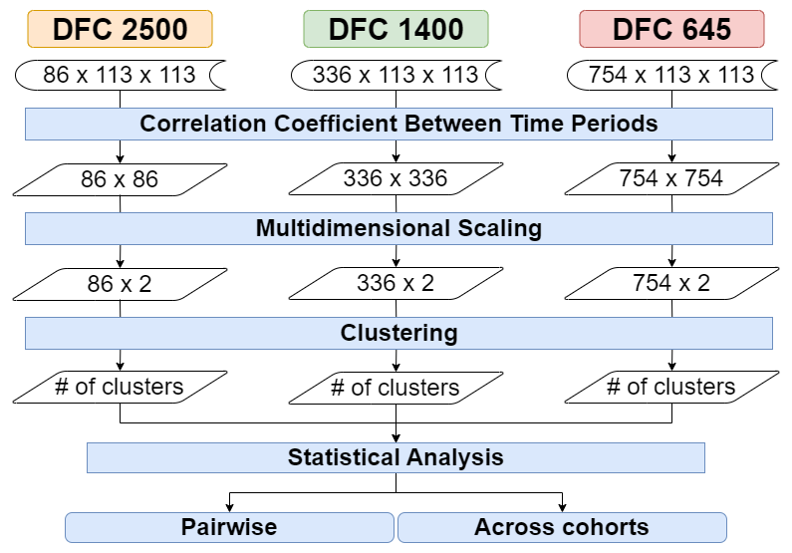
NonTDA-based Pipelines
Direct time-series clustering pipeline
PCA-based dimensionality reduction and clustering pipeline
Traditional FCN analysis pipeline

Slide 47
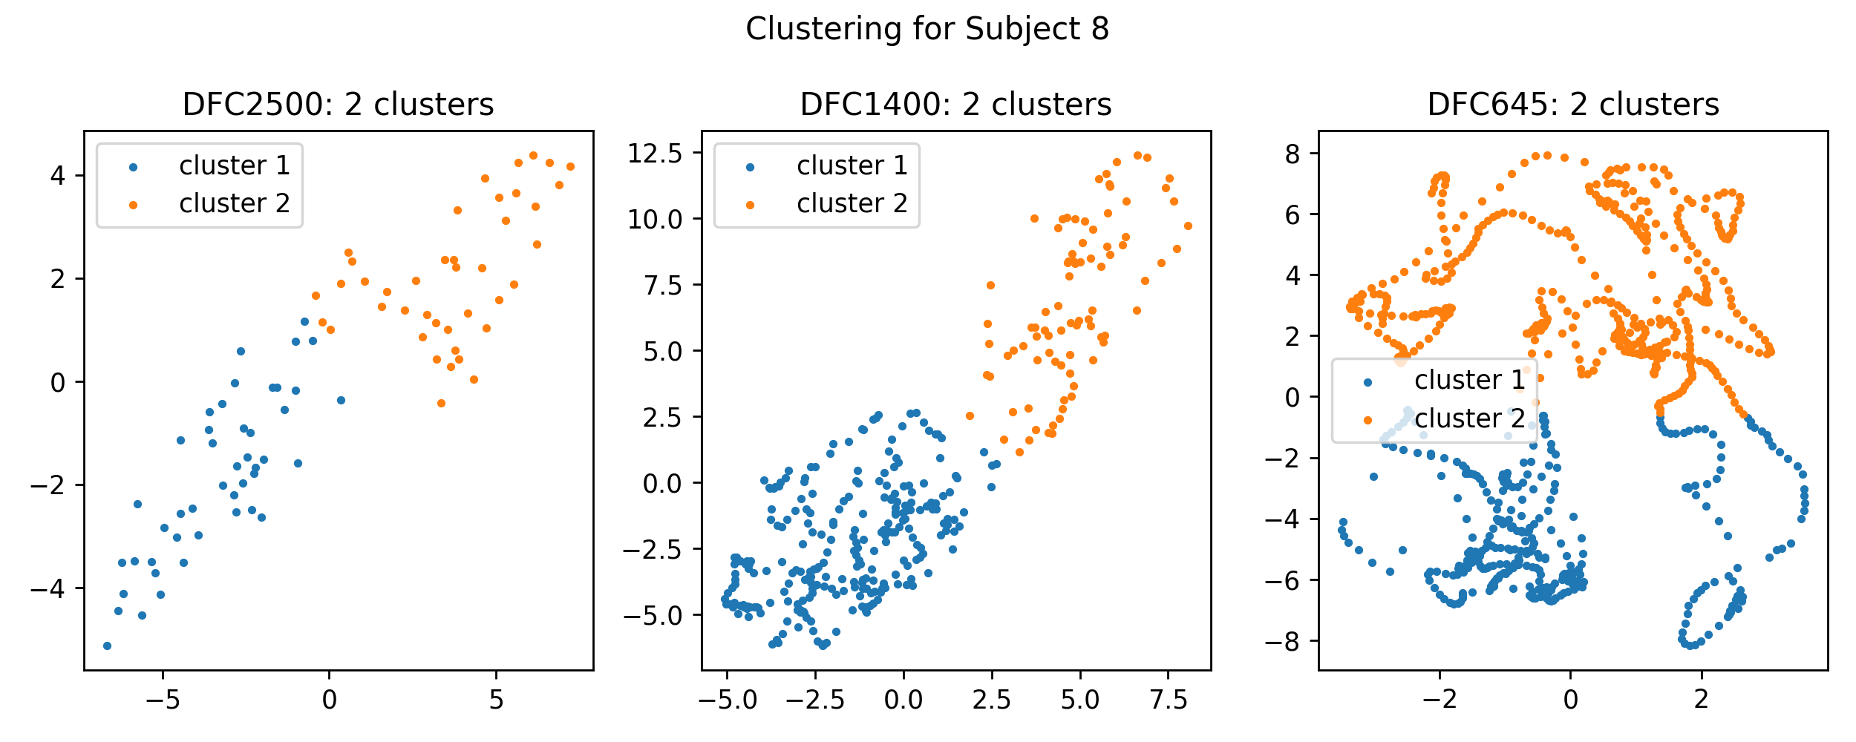
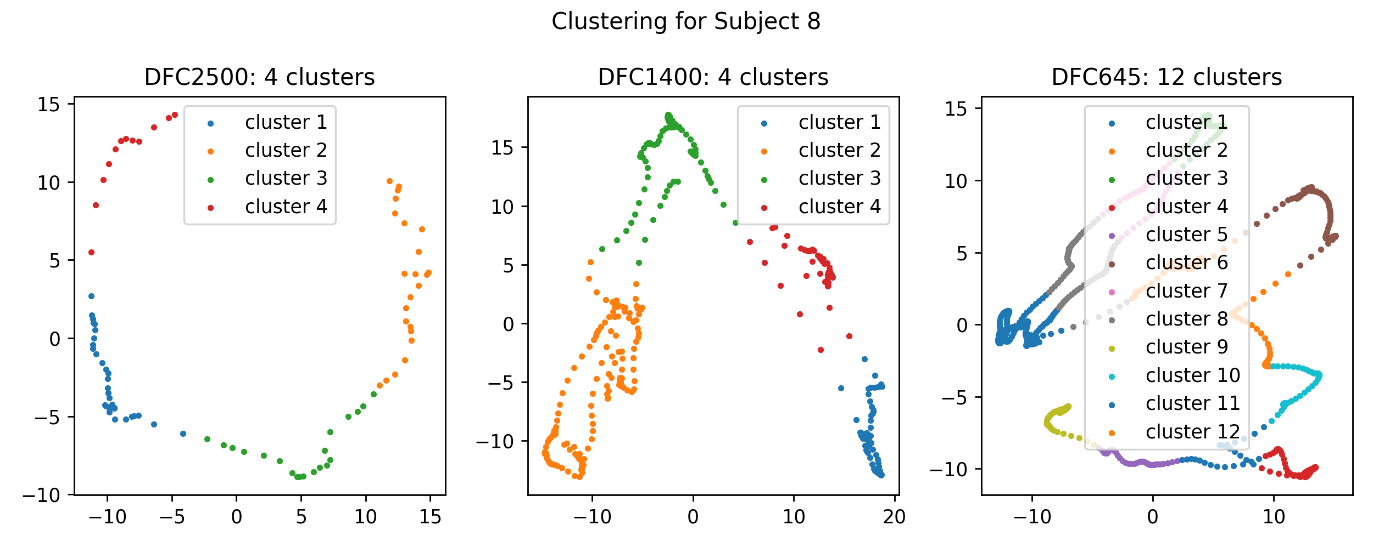
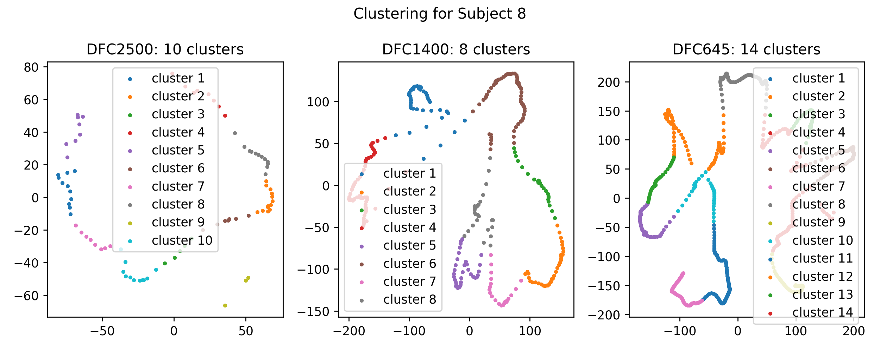
Clustering result for a single subject
Clustering result for subject 8 across different temporal periods using TDA-based data analysis pipeline (top row). Comparative results for the same subject employing nonTDA-based pipelines, PCA-based dimensionality reduction and clustering (middle row), and the traditional FCN analysis pipeline (bottom row).

Slide 48
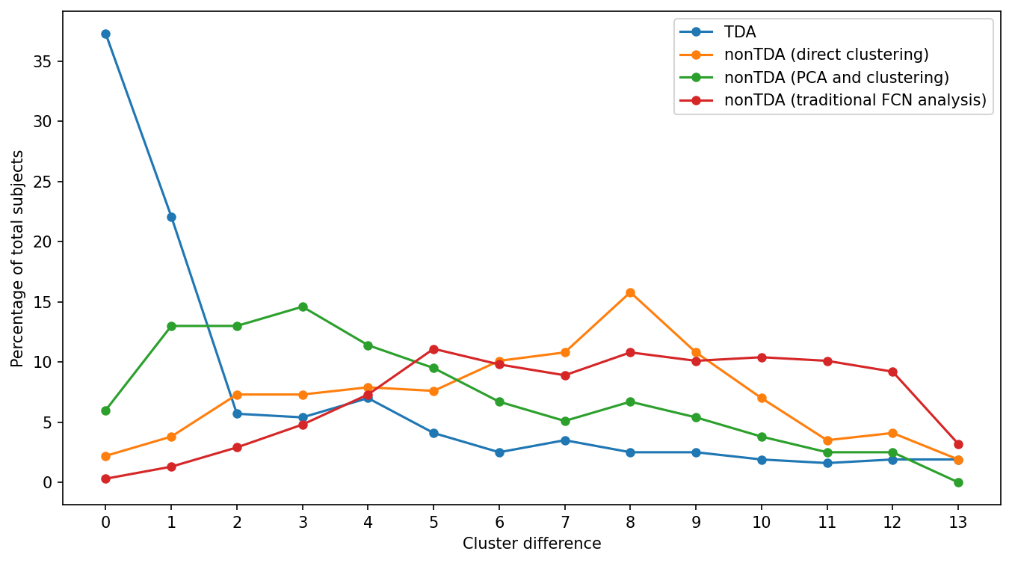
Cohort-wide cluster distance comparison
TDA-based pipeline has more than 59%
of the total subjects with cluster difference <=1
indicating the highly robust cluster patterns
consistent across cohorts
Cohort-wide cluster distance comparison between TDA-based statistical data processing pipeline and nonTDA-based pipelines

Slide 49
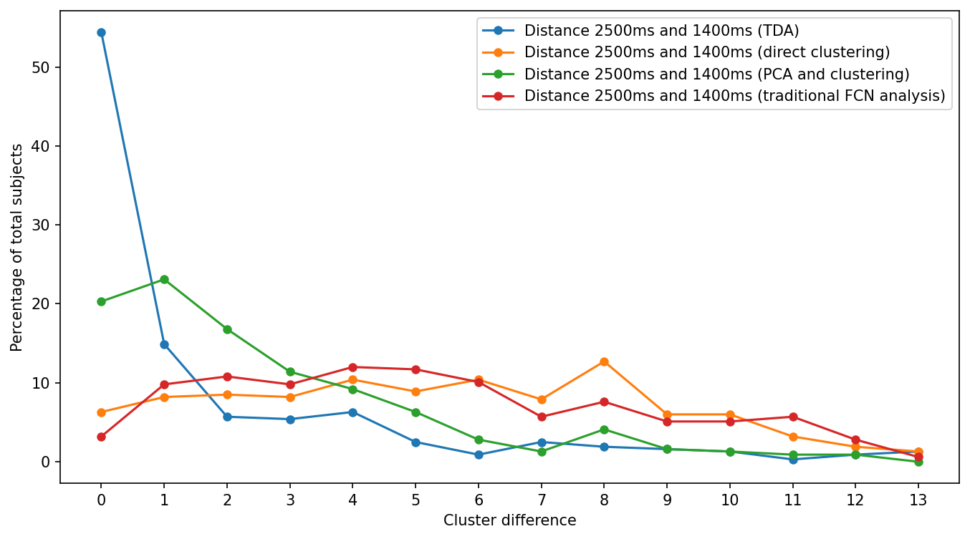
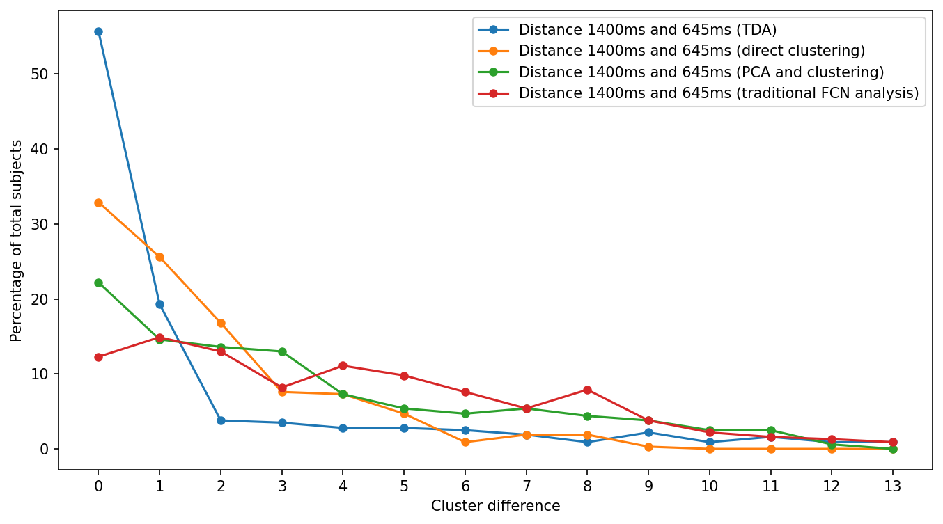
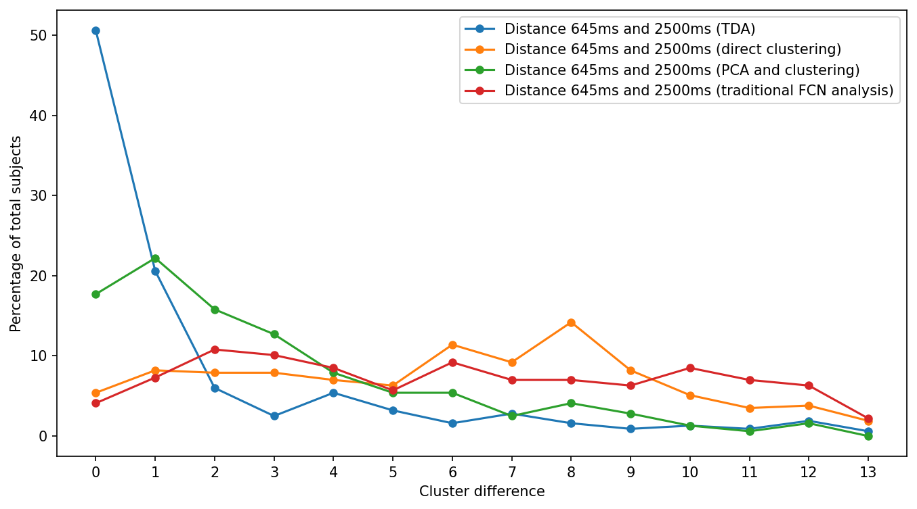
Pairwise cluster distance comparison
78% matching within distance <=2
77% matching within distance <=2
74% matching within distance <=2
Pairwise cluster distance comparison between TDA-based data processing pipeline and nonTDA-based pipelines. Comparison between pairwise temporal sampling rates:
1400ms and 2500ms (top row), 645ms and 1400ms (middle row), 645ms and 2500ms(bottom row)

Slide 50
Conclusion

Slide 51
Conclusion
Demonstrated the efficacy of TDA-based techniques in analysing FCNs from different TRs for both static and dynamic brain networks
Barcodes extracted from different scans of the same subject with different TRs captures similar structure
Open sourced code, data, docs https://github.com/harp-lab/brainPH (case 1) https://github.com/harp-lab/temporalPH (case 2)

Slide 52

Collaboration
Dr. Gopikrishna Deshpande
Professor Department of Electrical and Computer Engineering Auburn University, AL.
Affiliated with:
AU MRI Research Center, AL
Department of Psychological Sciences, AU, AL
Alabama Advanced Imaging Consortium, Birmingham, AL
Center for Neuroscience, AU, AL
School of Psychology, Capital Normal University, Beijing, China

Slide 53
Publications
Kumar, S., Shovon, A. R., & Deshpande, G. (2023). The robustness of persistent homology of brain networks to data acquisition‐related non‐neural variability in resting state fMRI. Human Brain Mapping, 44(13), 4637-4651.
Shovon, A. R., Kumar, S., & Deshpande, G. Topology assisted clustering of temporal fMRI brain networks with use-case in mitigating non-neural multi-site variability. Manuscript in submission.

Slide 54
Thank you

